Slide 1
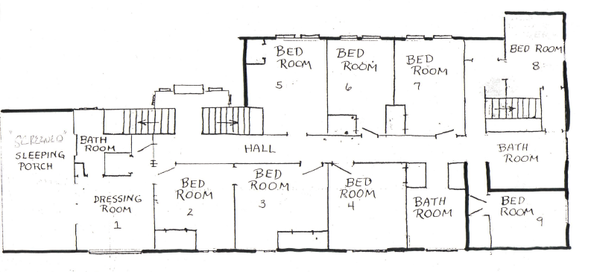
Watres Lodge Bedrooms
Bath Room
1 full bed (sleeps 1-2)
Room 5
2 bunk beds (sleeps 4)
Room 6
2 bunk beds (sleeps 4)
Room 7
Sleeping porch
Bath Room
1 full bed
(sleeps 1-2)
Room 8
1 full bed
(sleeps 1-2)
Room 3
Full Bed (Sleeps 1-2)
1 queen bed (sleeps 1 -2)
Room 2
1 full bed (sleeps 1-2)
Room 4
3 bunk beds
(sleeps 6)
Bath Room
2 bunk beds (sleeps 4)
Room 9
Lounge
Ice House: Sleeps up 2-4 (king, full)

